Slide 1
Asynchronous Invocation
Service-Oriented Software Engineering
Software Institute
Nanjing University
Bei Jia

Slide 2
Asynchronous Invocation
JAX-WS provides easy-to-use APIs for asynchronous invocation. Using these APIs, along with the interface java.util.concurrent.Future<T>, you don’t have to worry about thread use and other low-level concurrency issues in order to invoke Web services asynchronously
The JAX-WS API provides two approaches to asynchronous processing:
  In polling, your code is responsible for polling an instance of java.xml.ws.Response<T> (which extends Future<T>) to determine when a Web service invocation has completed
  In callback, your code supplies an instance of javax.xml.ws.AsyncHandler to process the results of the Web service invocation. When the Web service returns its results, they are automatically processed by the AsyncHandler instance you provided

Slide 3
Polling Client.java (1/2)
…
URL wsdlURL = new URL("http://"+host+":"+port+
"/chap06-endpoint-endpoint-1.0/requestOrder?wsdl");
QName serviceQName =
new QName("http://www.example.com/req", "RequestOrderService");
Service service = Service.create(wsdlURL, serviceQName);
QName portQName =
new QName("http://www.example.com/req", "RequestOrderPort");
Dispatch<Source> dispatch = service.createDispatch(portQName,
Source.class, Service.Mode.PAYLOAD);
Response<Source> responseSource = dispatch.invokeAsync(xmlSource);
long startTime = (new Date()).getTime();
while (!responseSource.isDone()) {
Thread.sleep(10);
}
long elapsed = (new Date()).getTime() - startTime;
Source orderSource = responseSource.get();
…

Slide 4
Polling Client.java (2/2)
The Web service is invoked using the Dispatch<T>.invokeAsync(T msg) method. Under the covers, this method uses the java.util.concurrent.Executor associated with the Service instance that created the Dispatch<T> to invoke the Web service using a separate thread.
The asynchronous invocation returns an instance of Response<Source>. The javax.xml.ws.Response<T> interface is a wrapper around Future<T> that provides an additional method— getContext()—to retrieve the response message context
isDone() method to determine when the asynchronous invocation has completed
get() method from Future<T> to retrieve the response message payload as an instance of Source

Slide 5
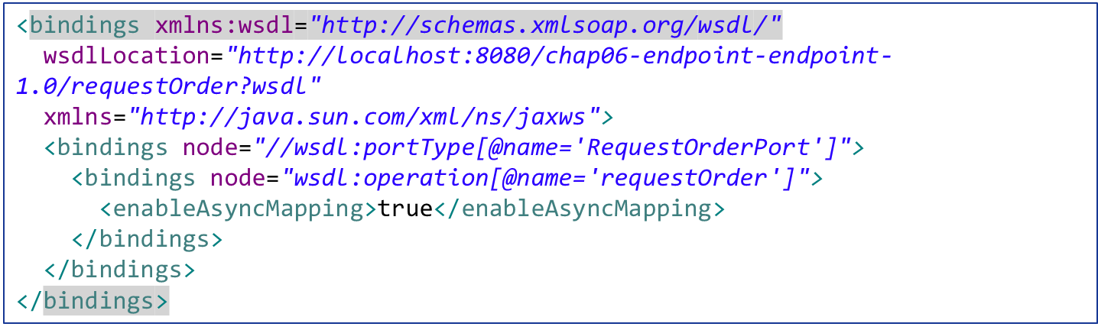
Asynchronous Methods with Proxies (1/2)
In addition to the asynchronous invocation methods on the Dispatch<T> interface, JAX-WS specifies that implementations must make it possible to generate SEIs with client-side asynchronous methods
User must be able to specify the generation of these asynchronous methods using binding language declarations async-binding-customizations.xml

Slide 6
Asynchronous Methods with Proxies (2/2)
If synchronous mapping of the target wsdl:operation looks like this: Xxx port.yyyZzz()
  The polling form of the asynchronous mapping will get Response<Xxx> port.yyyZzzAsync()
  The callback form of the asynchronous mapping will get Future<?> port.yyyZzzAsync(..., AsyncHandler<Xxx> asyncHandler)
Client.java
RequestOrderPort port = service.getRequestOrderPort();
Response<RequestOrderResponse> response = port.requestOrderAsync(
"ENT0072123", null, createCreditCard(), createItemList());
Future<?> response1 = port.requestOrderAsync(
"ENT0072123", "", createCreditCard(), createItemList(), cbh);
Future<?> response2 = port.requestOrderAsync(
"ENT0072123", "", createExpiredCreditCard(), createItemList(), cbh);

Slide 7
Callback Client.java (1/2)
…
URL wsdlURL = new URL("http://"+host+":"+portVal+
"/chap06-endpoint-endpoint-1.0/requestOrder?wsdl");
QName serviceQName =
new QName("http://www.example.com/req", "RequestOrderService");
Service service = Service.create(wsdlURL, serviceQName);
QName portQName =
new QName("http://www.example.com/req", "RequestOrderPort");
RequestOrderPort port = service.getPort(portQName,RequestOrderPort.class);
RequestOrderCallbackHandler cbh = new RequestOrderCallbackHandler();
cbh.setStartTime((new Date()).getTime());
Future<?> response1 = port.requestOrderAsync(
"ENT0072123", "", createCreditCard(), createItemList(), cbh);
Future<?> response2 = port.requestOrderAsync(
"ENT0072123", "", createExpiredCreditCard(), createItemList(), cbh);
try {
response1.get(2000, TimeUnit.MILLISECONDS);
} catch (TimeoutException te) {
response1.cancel(true);
}
…

Slide 8
Callback Client.java (2/2)
Service instance is created, and the getPort() method is used to create a proxy instance of the SEI RequestOrderPort
AsyncHandler<T> instance: RequestOrderCallbackHandler is created and used
In addition to other parameters, port.requestOrderAsync()also contains AsyncHandler<T>
The asynchronous invocations return instances of Future<?>
Future<?> can be polled to set time limit
AsyncHandler<RequestOrderResponse> is implemented to handle the response SOAP messages
According to the JAX-WS specification, if a wsdl:operation asynchronous invocation fails, neither a SEI-specific exception nor a SOAPFaultException gets thrown directly; instead, it throws a java.util.concurrent.ExecutionException instance is returned from the Response.get() method
The cause of the ExecutionException, retrieved using the getCause() method, contains either the SEI-specific exception or a protocol-specific exception such as SOAPFaultException

